Slide 1

WALL STREET MEETS AI
AI-DRIVEN STOCK SELECTION
FOR HIGH -PERFORMING PORTFOLIOS
DARES Analytics | Team Gordon

Slide 2
TEAM GORDON
DATA CLEANING
Merged 3 datasets (i.e. Ratios, Returns, Sectors) into one dataset (148,000+ rows)
Re-named variables for easy understanding
Removed 3 sectors that were not required
Imputed Sectors data with one-hot encoding
Converted all columns to int64 and float74
During the Exploratory Data Analysis (EDA) the following steps were taken:
Identified outliers & missing data
Applied a 5% winsorization to reduce extreme outliers
Removed rows with > 50% missing values (3,000+ rows reduced)
Removed columns with > 25% missing values (2 variables reduced)

Slide 3



TEAM GORDON
DATA PRE-PROCESSING
MISSING VALUE IMPUTATION (4 STAGES):
SCALED DATA (1ST STAGE):
STAGE 1: Drop rows with missing ticker values
STAGE 2: Fill missing values with 6 month moving window-based mean imputation with sector & timestamp-based groups
STAGE 3: Fill missing values with 12 month moving window-based mean imputation with sector & timestamp-based groups
STAGE 4: Imputed the remaining with mean derived from all the data from the beginning up to the selected timestamp
Scaled data to zero mean, and then unit variance grouped by timestamps
MULTICOLLINEARITY CHECK
Used Heatmap & Variance Inflation Factor (VIF) to detect correlated features
High-VIF features were removed (3 variables reduced)

Slide 4


TEAM GORDON
DATA PRE-PROCESSING - CONTINUED
PCA TRANSFORMATION
Category | Original Variables | PCA Components
Profitability | ROA, ROE, ROCE, NPM, OPM_AD, OPM_BD, PreTaxPM, CFM | PCA_Profitability_1, PCA_Profitability_2
Valuation_PE | PE_OpB, PE_OpD, PE_Exc, PE_Inc | PCA_Valuation_PE_1, PCA_Valuation_PE_2
Leverage | D_A, D_Cap, DE%, LTD_TL, TL_InvCap, LTD_InvCap | PCA_Leverage_1
Liquidity | Cash%, Quick%, Current%, CashConv, OCF_CL, PreDeprPrft_CL | PCA_Liquidity_1, PCA_Liquidity_2
Efficiency | InvTO, AssetTO, RecTO, PayTO | PCA_Efficiency_1
Capital_Allocation | Eq_InvCap, PstTax_AvEq, PstTax_InvCapx | PCA_Capital_Allocation_1, PCA_Capital_Allocation_2
Grouped financial ratios into 6 categories
Applied PCA to reduce dimensionality to 10 components while preserving 95% variance
4 valuation ratios (PS, PB, EVM, CAPEI) are kept for better interpretability
Therefore, the above process narrowed down 66 variables to 14 variables
SCALED DATA (2ND STAGE):
Applied RobustScaler after PCA to stabilize both the x & y variables
Applied the 10% winsorization to remove outliers & 2 high-VIF columns
Notes:
PCA –
ROBUSTSCALER –
WINSORIZATION -

Slide 5


TEAM GORDON
READY TO MODEL
17 X- VARIABLES
FINAL DATA READINESS CHECK
Price Multiples: PS, PB, EVM, PCA_Valuation_PE_1, PCA_Valuation_PE_2
Ratios: PCA_Profitability_1, PCA_Leverage_1, PCA_Liquidity_1, PCA_Efficiency_1, PCA_Capital_Allocation_1, PCA_Capital_Allocation_2
Sectors: Sector_Communication, Sector_Consumer Staples, Sector_Energy, Sector_Industrials, Sector_Materials, Sector_Utilities
Ensured cleaned, normalized and transformed dataset with no missing values
TWO DATASETS TO WORK WITH
Single-scaled Dataset
Double-scaled Dataset
FINALIZATION OF VARIABLES
Y-Variable: Return_Next 3M
X-Variable: 17 variables

Slide 6
TEAM GORDON
MODEL BUILDING
Model Type | Models | Scaling | Key Features
RollingOLS Regression | Model 1 & 2 | Single | Time-series regression
RollingOLS Regression | Model 3 | Double | With additional normalization
Logistic Regression | Model 4 | Single | Binary classification
Logistic Regression | Model 5 | Double | With additional normalization
Random Forest | Model 6 | Double | Binary classification with additional normalization

Slide 7
TEAM GORDON
MODEL METHODOLOGIES
Aspect | Model 1 & 2 (RollingOLS Single-scaled) | Model 3( RollingOLS Double-scaled) | Model 4 & 5 (Logistic Regression) | Model 6 (Random Forest)
Target Variable | Return_Next 3M (Continuous) | Return_Next 3M (Continuous) | Converted to Binary (Above/Below Median) | Converted to Binary (Above/Below Median)
Feature Engineering | Uses all available financial ratios | Uses all available financial ratios | Creates a binary classification target | Uses financial ratios & engineered features
Scaling Method | Single (StandardScaler) | Double (StandardScaler + RobustScaler) | Single & Double | Double (StandardScaler + RobustScaler)
Rolling Window | 36-months moving window | 36-months moving window | 36-months moving window | 36-months moving window
Model Complexity | Linear Model with Time-Series Adaptation | Linear Model with Time-Series Adaptation | Simple Binary Classification | Non-Linear Decision Trees
Evaluation Metrics | R², MSE | R², MSE | Accuracy, ROC AUC | Accuracy, ROC AUC

Slide 8

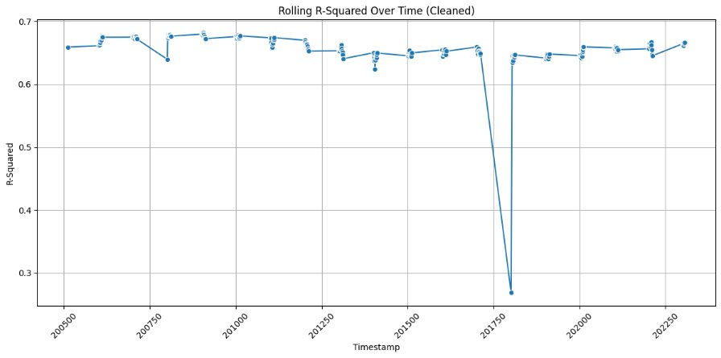
MODEL PERFORMANCE - MODEL 3 ROLLING OLS

Slide 9
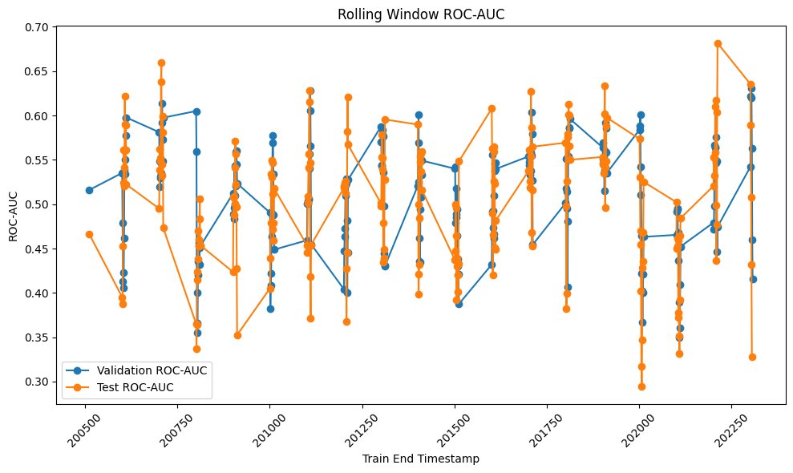
MODEL PERFORMANCE - MODEL 5 LOGISTIC

Slide 10
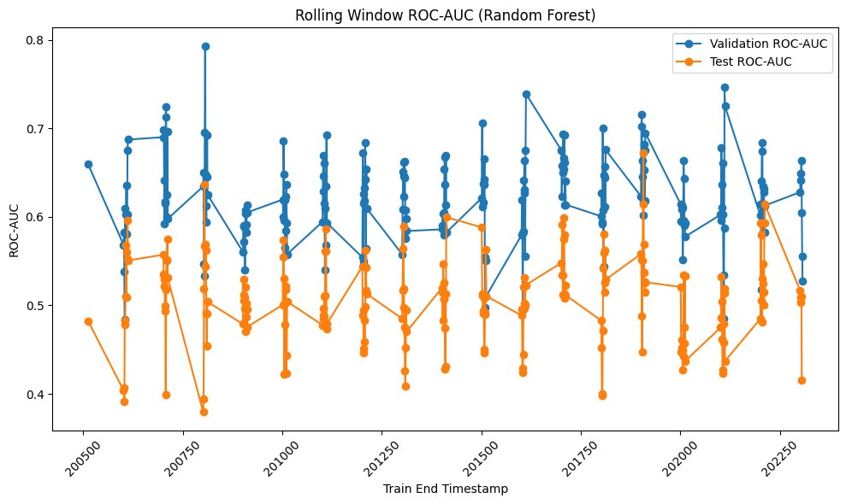
MODEL PERFORMANCE - MODEL 6 RANDOM FOREST

Slide 11


TEAM GORDON
MODEL OBSERVATIONS
Metric | RollingOLS(Model 1, 2 & 3) | Logistic Regression (Model 4 & 5) | Random Forest(Model 6)
Interpretability | HIGH | HIGH | LOWER (Black Box)
Handling Non-Linearity | POOR | POOR | GOOD
Robustness to Outliers | Model 1 & 2 are sensitive, Model 3 is better. | Double-scaled Model 5 is better | Handles outliers well
Time-Series Awareness | YES | NO | NO
Best for Time-Series Forecasting? | RollingOLS | NOT IDEAL | NOT IDEAL
Best for Classification? | Not designed for classification | DECENT | Best for complex relationships

Slide 12





MODEL
VERDICT
Model 6 - Random Forest Double-Scaled
Model 3 - RollingOLS Double-Scaled
Model 5 - Logistic Regression Double-Scaled
BEST FOR BINARY CLASSIFICATION
BEST FOR PREDICTING RETURNS
BEST FOR
SIMPLICITY

Slide 13

TEAM GORDON
SUPPLEMENTARY FILES
Portfolio Building
See Ranking 21 File
Portfolio Performance
See Charts 7, 8 & 9

Slide 14
TEAM GORDON
PORTFOLIO PERFORMANCE
Model | FinalCumReturn (%) | FinalCumReturn ($) | Avg Monthly Return (%) | Monthly Return StdDev (%)
Actual | 4.96E+10 | 4.96E+10 | 9.88 | 6.45
S&P500 | 282.11 | 382.11 | 0.72 | 4.48
DowJones | 251.66 | 351.66 | 0.68 | 4.32
Nasdaq | 580.69 | 680.69 | 1.03 | 5.28
SPTSX | 85.93 | 185.93 | 0.37 | 3.92
RollingOLS Single-scaled 1 | 1,587.15 | 1,687.15 | 1.37 | 3.25
RollingOLS Single-scaled 2 | 2,095.94 | 2,195.94 | 1.51 | 3.81
Logistic Single-scaled | 366.27 | 466.27 | 0.76 | 2.85
RollingOLS Double-scaled | 1,425.42 | 1,525.42 | 1.34 | 3.75
Logistic Double-scaled | 938.96 | 1,038.96 | 1.14 | 3.30
Random Forest | 30,873.56 | 30,973.56 | 2.73 | 2.85

Slide 15
TEAM GORDON
PORTFOLIO OBSERVATIONS
WIDE OUTPERFORMANCE
Model-based strategies (RollingOLS, Logistic, Random Forest) outstrip benchmarks significantly
RANDOM FOREST LEADS
3087.36% final return
grows $100 to ~$3,097.36
ROLLING OLS STRENGTH
All 3 Rolling OLS variants combine strong returns with manageable volatility, offering a balanced high-performance option
LOGISTIC LAGS BUT STILL BEATS
Double-scaled (938.96%) far exceeds benchmark returns yet, falls short of the RollingOLS and RandomForest outcomes
LOWER VOLATILITY
Random Forest and Logistic Single-scaled show ~2.85% monthly std. dev., well below the actual portfolio’s 6.45%
IMPOSSIBLITY OF “ACTUAL”
4.96E+10% final return is implausible - likely a scaling issue.

Slide 16
PORTFOLIO
VERDICT
Model 6 - Random Forest Double-Scaled
Model 3 - RollingOLS Double-Scaled
Model 5 - Logistic Regression Double-Scaled
HIGHEST
GAINS
MOST CONSISTENT
BALANCED OPTION

Slide 17
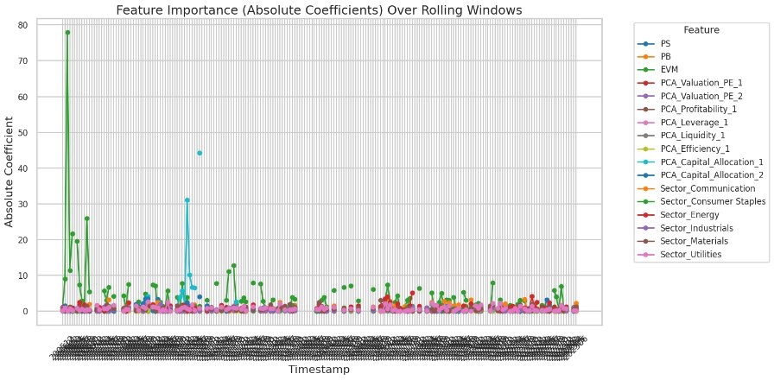
FEATURE IMPORTANCE - MODEL 3 ROLLING OLS

Slide 18
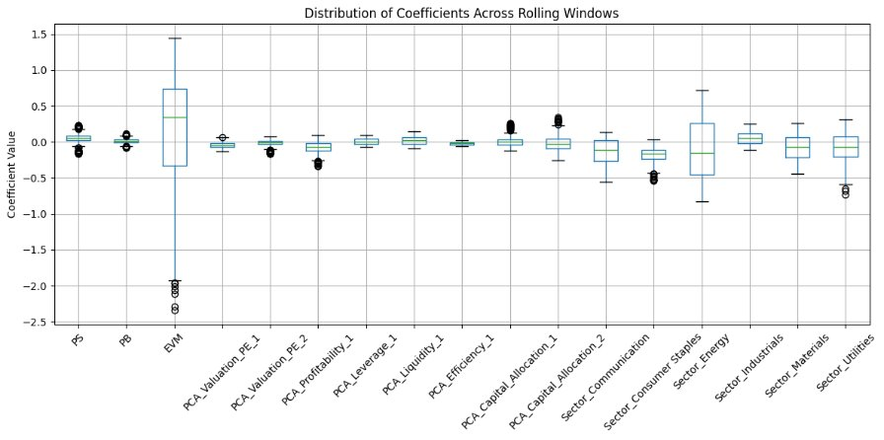
FEATURE IMPORTANCE - MODEL 5 LOGISTIC

Slide 19
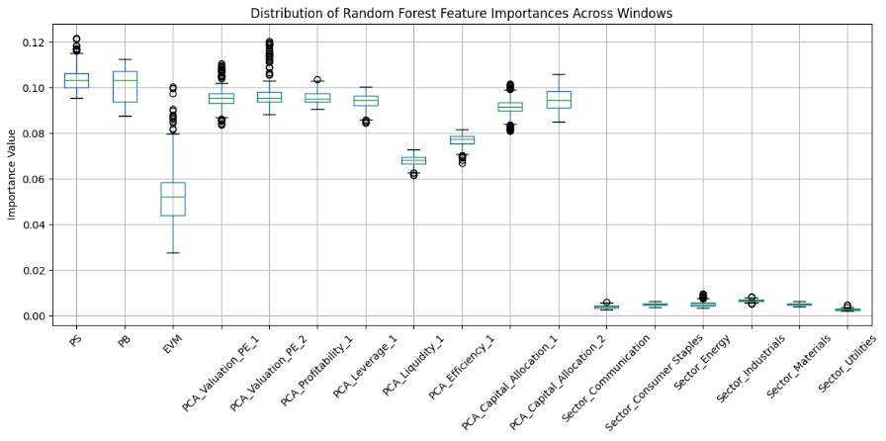
FEATURE IMPORTANCE - MODEL 6 RANDOM FOREST

Slide 20
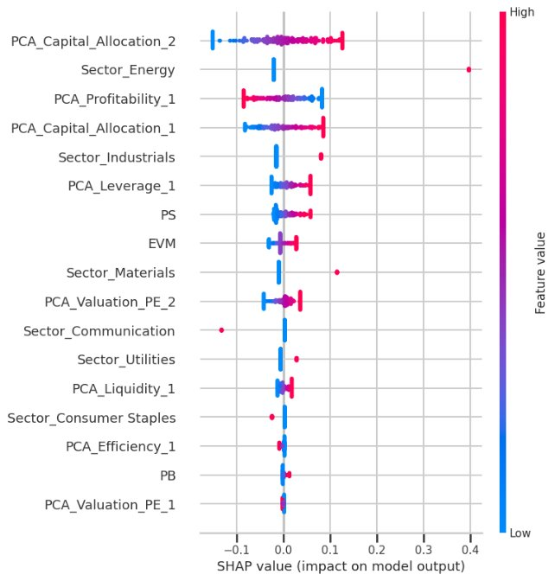
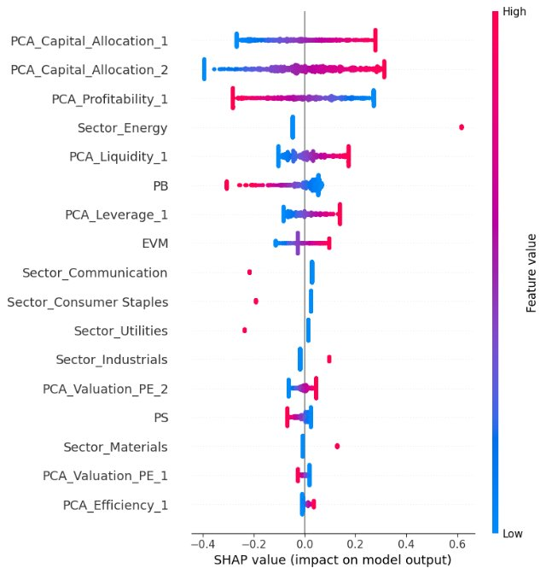
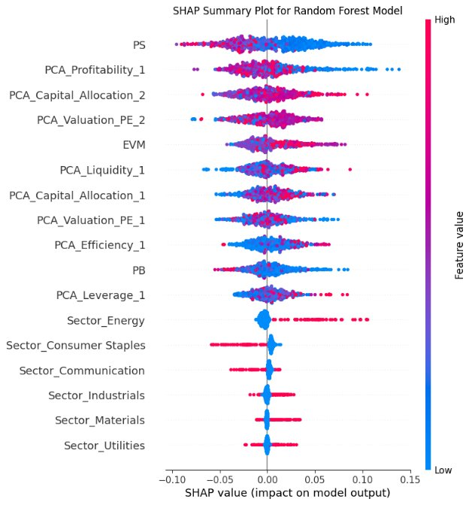
FEATURE IMPORTANCE - GLOBAL (SHAP)
* Shapley Additive exPlanations (SHAP) – how the individual features in the models contribute to the return prediction.

Slide 21
TEAM GORDON
FEATURE IMPORTANCE - GLOBAL (SHAP)
Aspect | Observations | Implications
Magnitude Differences | Model 5: Highest SHAP Model 6: Lowest Model 3: Moderate | Logistic model stresses strong predictors; focus on ranks.
Key Features | PCA_Profitability_1 is top in all. ​ PCA_Capital_Allocation_1/2 are high in Model 5. | Profitability and capital allocation drive outcomes consistently.
Sector Effects | Sector_Energy is strong in Models 3 & 5, weak in Model 6. ​Other sectors vary. | Linear/logistic models capture sectors directly; RF spreads effects.
Variability & Sensitivity | Model 3 has higher variability; Model 6 is more consistent. | Variability shows differing feature impact; consistency aids reliability.

Slide 22
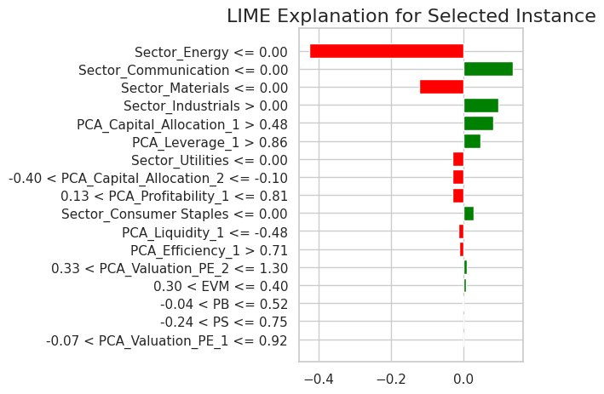
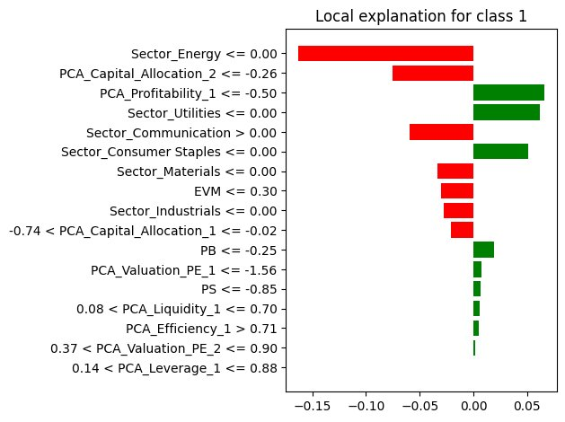
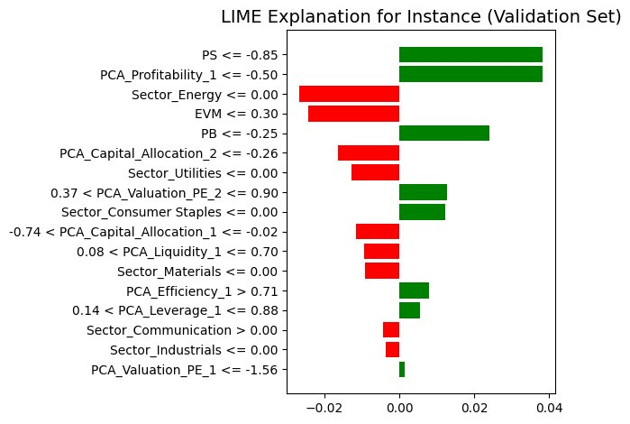
FEATURE IMPORTANCE - LOCAL (LIME)
* Local Interpretable Model-Agnostic Explanations (LIME) – tells you why a specific return prediction was made based on the most relevant features of that particular data point.

Slide 23
TEAM GORDON
FEATURE IMPORTANCE - LOCAL (LIME)
Model | Highest Impact Feature (Impact Value) | Key Observations | Recommendations
Model 3 (RollingOLS) | Sector_Energy (0.425) | Sector_Energy has a very strong negative effect, pulling the prediction down a lot. | Review energy sector data closely and check if its strong influence is justified or if the model over-relies on it.
Model 5 (Logistic) | Sector_Energy (0.163) | Sector_Energy still drives the prediction downward, but the effect is milder. | Ensure that energy sector signals are consistent; compare with other models to validate its influence.
Model 6 (Random Forest) | PS (0.0383) | No single feature dominates; here, PS slightly increases the prediction, with overall effects spread. | Look at the combined effect of many features instead of one dominant driver; use this model for a balanced view of factors.

Slide 24


TEAM GORDON
OUR MODEL VS GPT
ADAPTIVE STORYTELLING
QUALITATIVE INSIGHTS
GPT incorporates a broader range of information - including recent news, market sentiment, and qualitative trends - that a basic OLS model (which relies strictly on historical numerical) data might miss.
The GPT approach builds a narrative around each stock’s fundamentals and market conditions.
NVIDA (NVDA) benefiting from the AI and semiconductor rally
Microsoft (MSFT) - driven by cloud growth and strong enterprise fundamentals
Costco (COST) - for its steady consumer demand and earnings stability
O’Reilly Automative (ORLY) - owing to its robust margins and resilience in the auto sector
CONTEXTUAL UNDERSTANDING
GPT can weigh macroeconomic context, sector dynamics, and even investor sentiment.

Slide 25
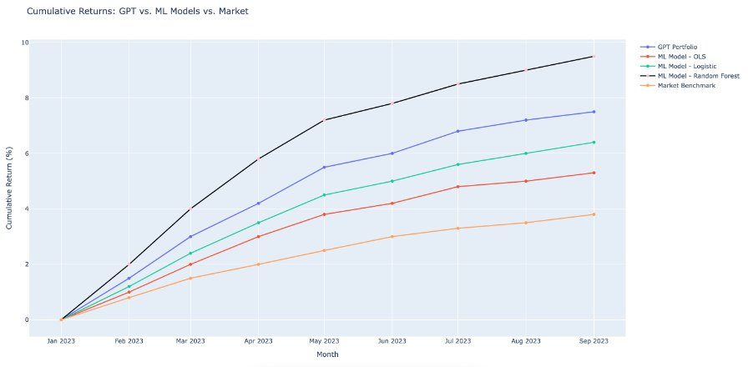
TEAM GORDON
OUR MODEL VS GPT

Slide 26

TEAM GORDON
RECOMMENDATIONS
01
PRIORTIZE HIGH-PERFORMERS
Use RollingOLS models, as they deliver the highest cumulative returns.
02
DIVERSIFY YOUR STRATEGY
Blend high-return models with more balanced ones (e.g. RollingOLS with and Logistic) to reduce volatility.
03
MITIGATE SECTOR BIAS
Adjust models to lessen over-reliance on Sector_Energy by incorporating macro and money market indicators.
04
ENHANCE WITH MACRO DATA
Integrate key macroeconomics and money market rates - related variables to improve model robustness.
05
MONITOR DRIVERS CONTINUOUSLY
Regularly apply SHAP & LIME analyses to ensure feature importance remains stable.
Notes:
PDP – predictive data analysis: provide useful visualizations of the relationship between the variable of interest and the model's predictions.

Slide 27

QUESTIONS?
Thank You for Attention
DARE ANALTYICS | TEAM GORDON

